Slide 1

CARGO TRACKING SYSTEM
L.R.G.GOVT ARTS COLLEGE FOR WOMEN
_{G.SINDHUMATHI}
_{III BSC CS SHIFT I}
_{GUIDED By: MRS.A.SANKARI MSC…}

Slide 2

Agenda
Abstract
Objective
Hardware Specifications
Software Specification
Existing System
Proposed System
Modules
Data Flow Diagram

Slide 3
ABSTRACT
The project entitled as “CARGO TRACKING SYSTEM” is a supply chain management.
The project contains two types of interaction like Admin and Customer. Admin has authority to add or remove goods in the System.
Customer can book the cargo by entering source and destination place.
The main advantage of the system are it excludes the use of paper work by managing all the records electronically. it saves the humans efforts and resources.

Slide 4

OBJECTIVE
cargo management system application solves all the entire problem are warehouse management, processing orders, inventory control and order tracking.
Customer can book the cargo by entering source and destination place.

Slide 5
HARDWARE SPECFICATION
Processor : P 4 700 GHz.
RAM : 4 GB RAM
Hard Disk Drive : 180 GB

Slide 6
SOFTWARE SPECIFICATION
Operating System : Windows 7/8/10
Front End : JAVA
Back End : SQL

Slide 7
EXISTING SYSTEM
The customer has to visit the office whenever they have any booking regarding the services, which is time consuming process. The registered booking may be forwarded to the workers in the specified department.
Drawbacks of Existing System
The process is done manually.
Due to that they face problems like data loss.
The customer does not know current location of the product.

Slide 8

PROPOSED SYSTEM
Previously, In Cargo Tracking system they were done manual. Now developed the site to make the things computerized.
The customer can submit the orders through the website. The orders can be tracked by the users. The website will collect more information from the user and give a better view to the booking of cargoes.
Advantages of Proposed System
Data is maintained in a structured format.
Reliable Customer Order Process.
User can view the location of orders.

Slide 9

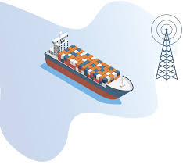
MODULES
Admin Login
Customer Registration
Ship Registration
Order Registration
Order Details
Tracking

Slide 10

Admin Login
Admin having an responsibility to perform the software.. We can refer the admin table and validating the username and password and perform into the login
Customer Registration
This module collects all the information about the customer like name, mobile number and address details etc.… these details has been stored into the customer details. When we need to collect the customer details can get here.

Slide 11
Ship Registration
Admin register the shipping details and register the ship, once ship has been registered can make an order under the ship. it also contains shipping details .
Order Registration
After the customer registration admin can able to register an order, this will collect all the information about the order details. Which collect the order product name, branch, from, to and weight also.
Order Details
This module shown the order details in this order details tab. We can see the order current status as well, also able to display the amount of the order.

Slide 12

TRACKING
The Customer can track the item details , look up the delivery status.
Manage the progress from the goods receipts , to extraction point and delivery point.

Slide 13

Data Flow Diagram
Level 0:

Slide 14
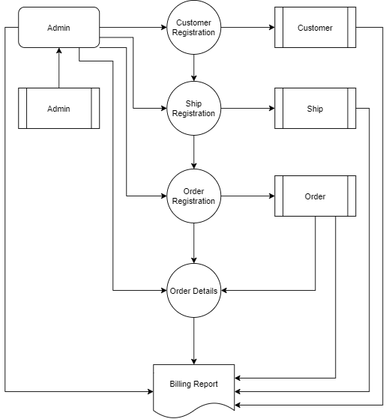
Level 1:

Slide 15
Table structure Table Name: Admin
Field Name | Data Type | Size | Constraints
Admin _id | int | 10 | Primary key
Name | Varchar | 25 | Not null
Email | Varchar | 25 | Not null
Phone | Int | 10 | Not null
Address | Varchar | 25 | Not null
Zip_ code | Int | 6 | Not null
Username | Varchar | 25 | Not null
Password | Varchar | 12 | Not null

Slide 16
Table Name: Ship
Field Name | Data Type | Size | Constraints
Ship id | Int | 10 | Primary key
Vehicle_number | Varchar | 12 | Not null
Vehicle_type | Varchar | 15 | Not null
Vehicle_model | Varchar | 15 | Not null

Slide 17
Table Name: Order
Field Name | Data Type | Size | Constraints
Order id | Int | 10 | Primary key
Name | Varchar | 20 | Not null
Address | Varchar | 25 | Not null
Pickup date | Date | 10 | Not null
Delivery date | Date | 10 | Not null
Weight | Numbers | 25 | Not null
Packing_type | Varchar | 25 | Not null
Company_name | Varchar | 20 | Not null
Company_address | Varchar | 25 | Not null
Mobile number | Number | 12 | Not null
Picklocation | Varchar | 15 | Not null
Drop location | Varchar | 15 | Not null
Customer_id | Int | 10 | Primary key

Slide 18
Table Name: Customer
Field Name | Data Type | Size | Constraints
Customer id | Int | 10 | Primary key
Name | Varchar | 25 | Not null
Email | Varchar | 25 | Not null
Phone | Number | 10 | Not null
Address | Varchar | 25 | Not null
Zip_code | Int | 6 | Not null

Slide 19
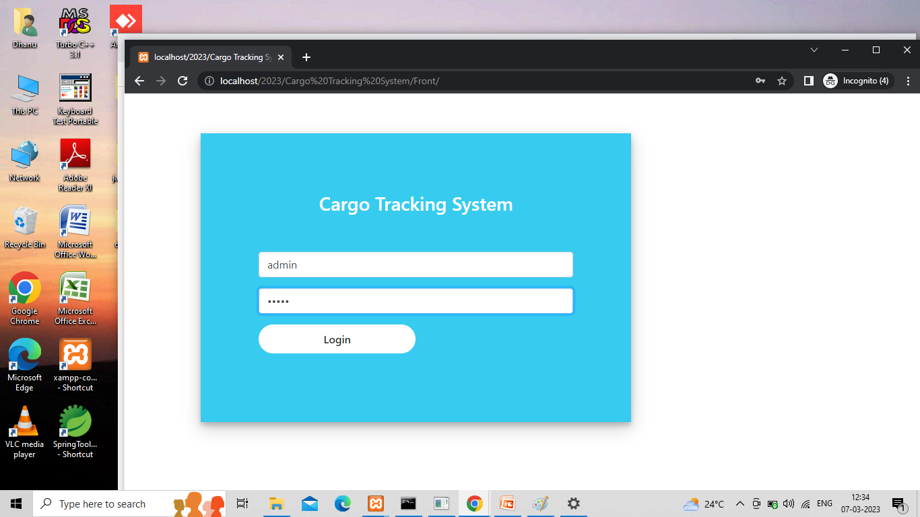
Form Design: admin login

Slide 20
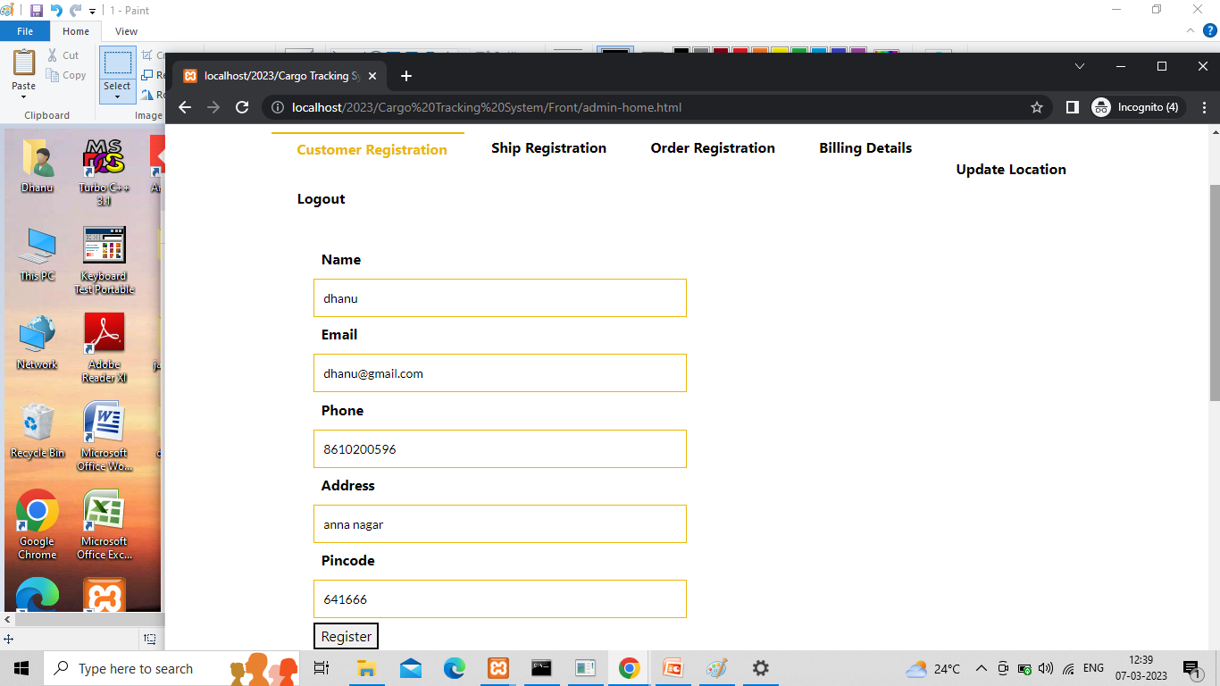
CUSTOMER REGISTRATION

Slide 21
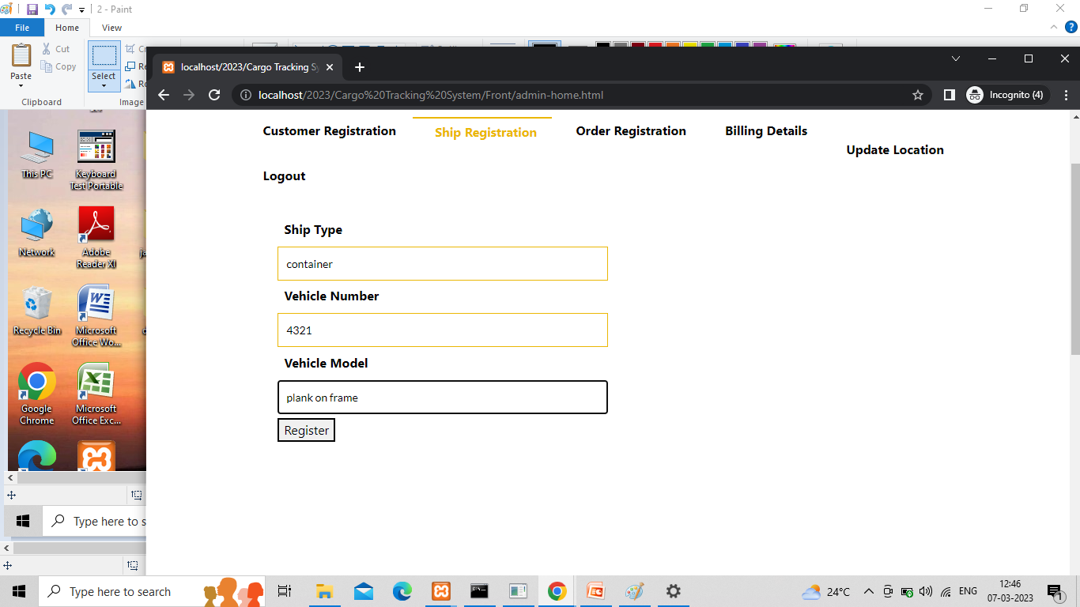
SHIP REGISTRATION

Slide 22
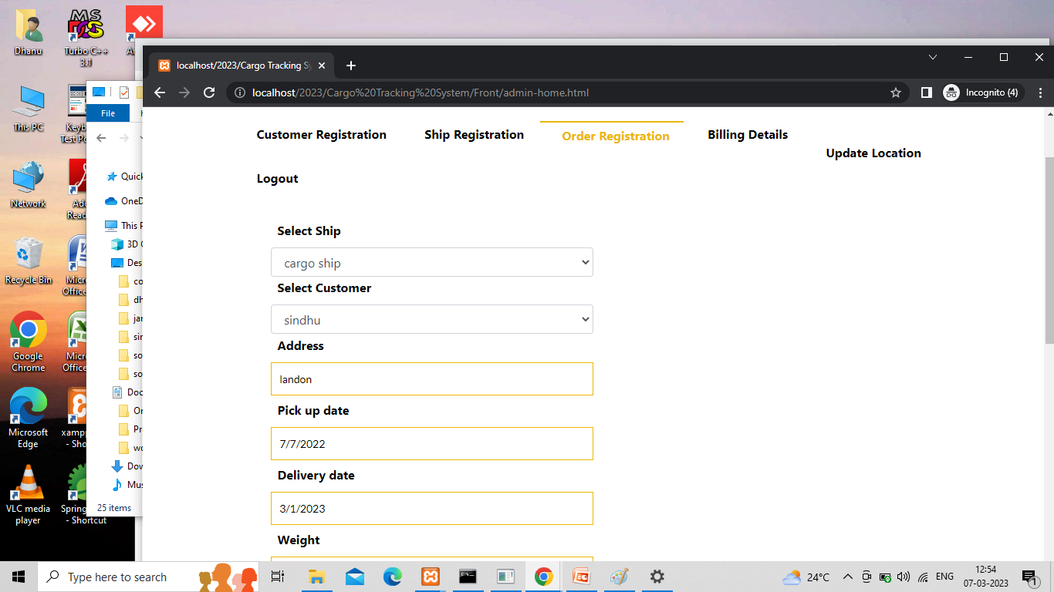
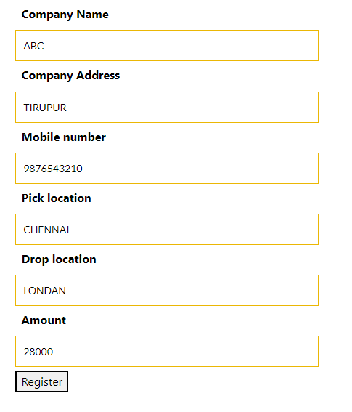
ORDER REGISTRATION

Slide 23
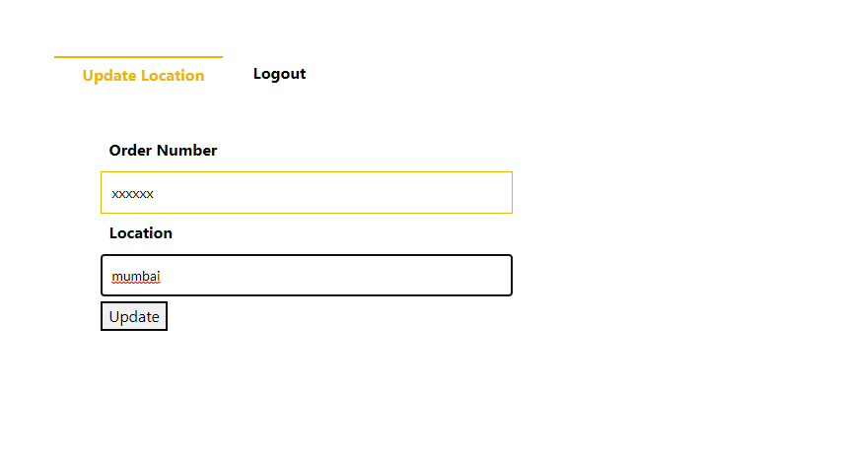
UPDATE LOCATION

Slide 24
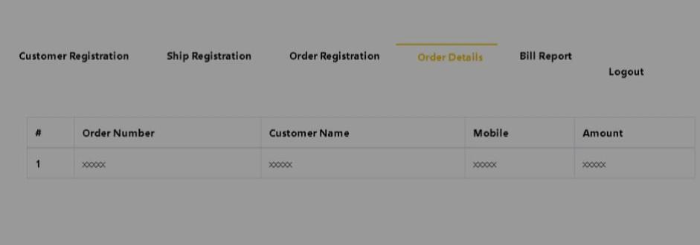
ORDER DETAILS

Slide 25

Thank You
Thank you everyone!!

